Slide 1
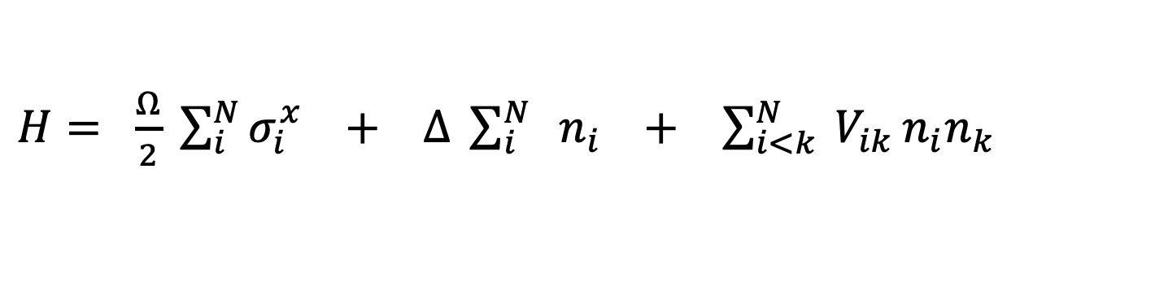
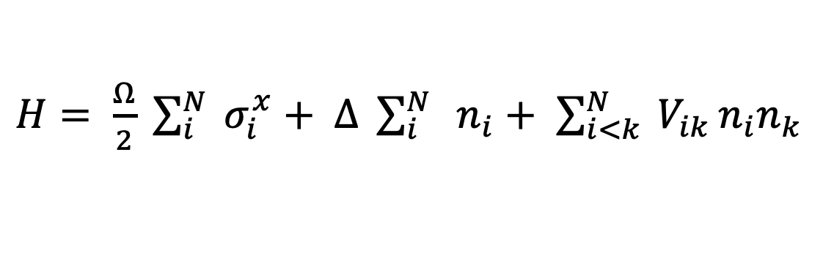
$H= \frac{Ω}{2} \sum_{i}^{N}{{ σ}_{i}^{x}}+$ $∆ \sum_{i}^{N}{ { n}_{i}}$ $+$ $\sum_{i<k}^{N}{ V_{ik}}n_{i}n_{k}$
$H= \frac{Ω}{2} \sum_{i}^{N}{σ_{i}^{x}} +$ $∆ \sum_{i}^{N}{ { n}_{i}}$ $+$ $\sum_{i<k}^{N}{ V_{ik}}n_{i}n_{k}$

Slide 2
|r⟩
Δ
Δ
|r⟩
`
Δ
Ω
Ω
Ω
|0⟩
|0⟩

Slide 3
|r⟩
|r⟩
Ω
Ω
|0⟩
|0⟩
Ω
Ω

Slide 4

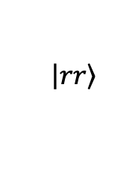

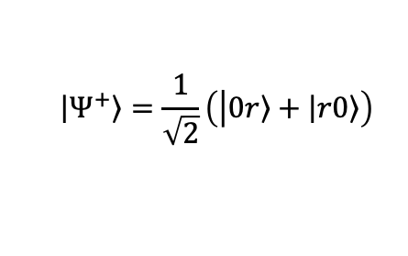


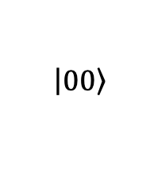
$$E$$
$$∝\frac{1}{R^{6}}$$
$$\left|\left.rr\right\rangle \right.$$
Ω
$$\left|\left.Ψ^{+}\right\rangle \right.=\frac{1}{\sqrt{2}}\left(\left|\left.0r\right\rangle +\left|\left.r0\right\rangle \right.\right.\right)$$
Ω
$$\left|\left.00\right\rangle \right.$$
$$R_{B}$$
$$R$$

Slide 5
|r⟩
Δ
Δ
Rydberg state, |r⟩
Δ
Ω
Ω
Ω
|0⟩
Ground state, |0⟩

Slide 6
Δ
|r⟩
Ω
|0, 0⟩

Slide 7



Rydberg
Blockade
$$Ω_{0}$$
$${2 Ω}_{0}$$
$$Ω_{0}$$

Slide 8

Rydberg
Blockade
$$Ω_{0}$$
$$\sqrt{2}{ Ω}_{0}$$
$${2 Ω}_{0}$$
$$Ω_{0}$$

Slide 9
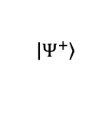
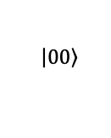
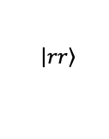
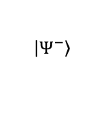
$$\left|\left.00\right\rangle \right.$$
$$\left|\left.Ψ^{−}\right\rangle \right.$$
$$\left|\left.Ψ^{+}\right\rangle \right.$$
$$\left|\left.rr\right\rangle \right.$$

Slide 10
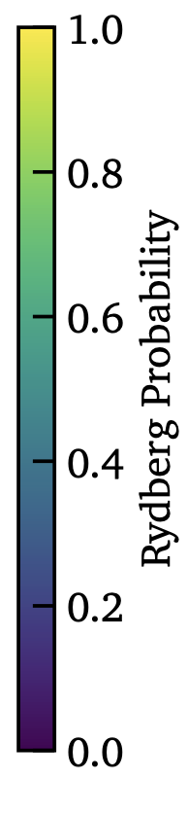
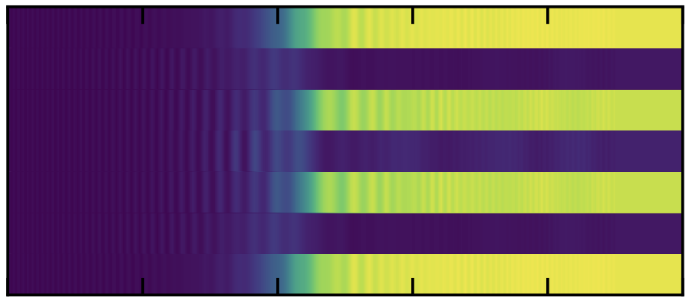

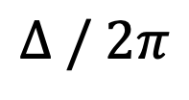
Equilibrium Dynamics: Adiabatic Quantum Phase Transitions
$$∆ / 2π$$
Rydberg state, |r⟩
-30 (MHz)
0
30 (MHz)
$$ℤ_{2}$$
Ground state, |0⟩

